Slide 1
CSE496: Partial project presentation on DDoS detection using machine learning
Instructor:
Annajiat Alim Rasel (AAR)
MD. Faisal Ahmed (FLA)
Group Members:
Mahdi Hossain - 20301194
Kazi Shahed Mamun - 20301471
Taimoor Fahim - 23241093

Slide 2
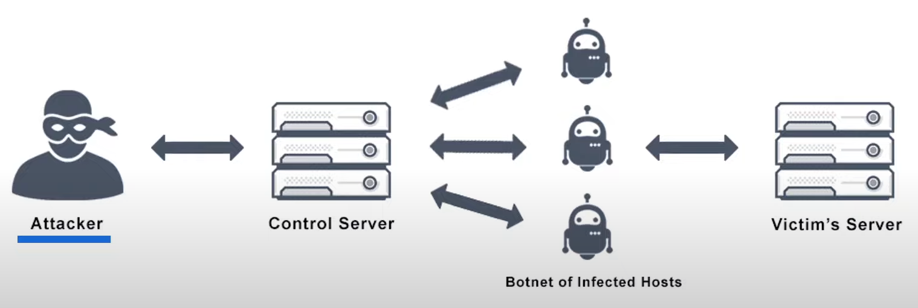
DDoS attack classification by Machine Learning

Slide 3
Dataset
We have used the dataset CIC-DDoS2019 for training our model.
Dataset has attack network flows and normal network flows.
The data is imbalanced towards DDoS attack networks so we have to balance the dataset first before pre-processing.
It also includes the results of the network traffic analysis using CICFlowMeter-V3.

Slide 4
Machine Learning and Algorithms
Machine learning algorithms is used by identifying patterns in data, making them suitable for DDoS attack classification by analyzing network traffic features, the model can learn to distinguish between normal activity and attack signatures.
Random Forest
Logistic Regression
Neural Networks
Then we will compare all the models that were trained under the algorithms to find out which model had the best accuracy in determining the DDoS attacks flows.

Slide 5
Machine Learning and Algorithms
Machine learning algorithms is used by identifying patterns in data, making them suitable for DDoS attack classification by analyzing network traffic features, the model can learn to distinguish between normal activity and attack signatures.
Random Forest
Logistic Regression
Neural Networks
Then we will compare all the models that were trained under the algorithms to find out which model had the best accuracy in determining the DDoS attacks flows.

Slide 6
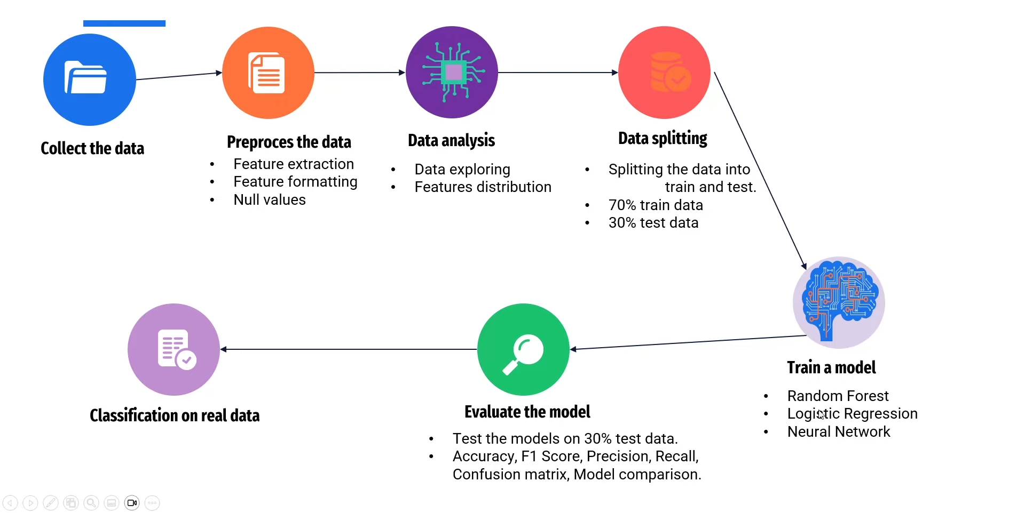
Project Pipeline

Slide 7
THANK YOU

